Slide 1








GROUP PROJECT
Python Project

Slide 2








Our Team
1.Murshid 2.Sairabanu
3.Pranav 4.Keerthana

Slide 3




Rank Based Percentile Gui Calculator using Tkinter
import tkinter as tk
from tkinter import tt
def calculate_percentile()
try
rank = int(rank_entry.get()
total_students = int(total_entry.get()
if (1 <= rank <= total_student):
percentile = ((total_students - rank + 1) / total_students) * 10
result_label.config(text=f"Percentile: {percentile:.2f}%"
else
result_label.config(text="Invalid rank"
except ValueErro
result_label.config(text="Please enter valid numbers"
# Create main wind
window = tk.Tk(screenName="-display :0.0"
window.title("Percentile Calculator"
# Create and place widge
rank_label = ttk.Label(window, text="Enter Rank:"
rank_label.grid(row=0, column=0, padx=10, pady=10, sticky="e"
rank_entry = ttk.Entry(windo
rank_entry.grid(row=0, column=1, padx=10, pady=10
total_label = ttk.Label(window, text="Total Students:
total_label.grid(row=1, column=0, padx=10, pady=10, sticky="e"
total_entry = ttk.Entry(windo
total_entry.grid(row=1, column=1, padx=10, pady=10
calculate_button = ttk.Button(window, text="Calculate Percentile", command=calculate_percentil
calculate_button.grid(row=2, column=0, columnspan=2, pady=10
result_label = ttk.Label(window, text="
result_label.grid(row=3, column=0, columnspan=2, pady=10)"))e))w))"))w)))ts))ow)r:):)0s:)):):k

Slide 4
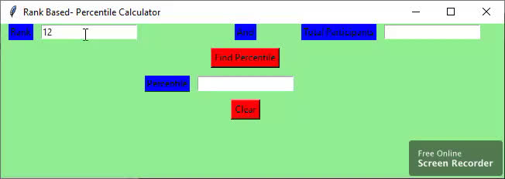
FINAL OUTPUT

Slide 5

